Slide 1
Timed Math Quiz

Slide 3
In This Part, You Learn How to
Generate random numbers by using the Random class.
Trigger events to occur at a specific time by using a Timer control.
Control program flow by using if else statements.
Perform basic arithmetic operations in code.

Slide 4
To create a project and and set properties for a form
Create new Project:: MathQuiz || Text Math Quiz.
Change the size of the form to 500 pixels wide by 400 pixels tall.
Change the value of the FormBorderStyle property to Fixed3D, and set the MaximizeBox property to False.
These values prevent quiz takers from resizing the form.

Slide 5
To create the Time Remaining box
Add a Label and set (Name) property to timeLabel.
Change the AutoSize property to False.
Change the BorderStyle property to FixedSingle.
Set the Size property to 200, 30.
Move the label to the upper-right corner of the form, where blue spacer lines will appear.

Slide 6
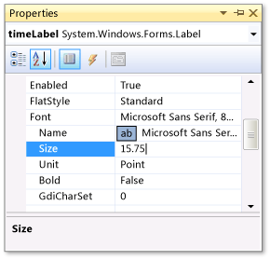
Clear Text property
Change the value of the Size property to 15.75.
Add Label, and then set its font size to 15.75.
Set the Text property to Time Left.

Slide 7
To add controls for the addition problems
Add a Label
Text -> ?
AutoSize->False.
Size->60, 50.
font size->18.
TextAlign->MiddleCenter.
Location->50, 75
(Name)->plusLeftLabel.

Slide 8
Copy plusLeftLabel label and Paste the label 3 times.
Arrange the three new labels so that they are in a row to the right of the plusLeftLabel label.
Set the value of the second label's Text property to + (plus sign).
Set the value of the third label's (Name) property to plusRightLabel.
Set the value of the fourth label's Text property to = (equal sign).

Slide 9
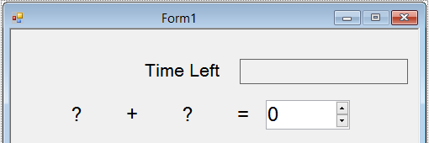
Add a NumericUpDown control
font size to 18, and set its width to 100.
(Name) ->sum.

Slide 10
To add controls for the subtraction, multiplication, and division problems
Copy all five controls and then paste them.
Change the value of the Text property for the second label to –.
Name the first question-mark label minusLeftLabel.
Name the second question-mark label minusRightLabel.
Name the NumericUpDown control difference.

Slide 11
Paste the five controls two more times.
For the third row, name the first label timesLeftLabel, change the second label's Text property to × (multiplication sign), name the third label timesRightLabel, and name the NumericUpDown control product.
For the fourth row, name the first label dividedLeftLabel, change the second label's Text property to ÷ (division sign), name the third label dividedRightLabel, and name the NumericUpDown control quotient.

Slide 12
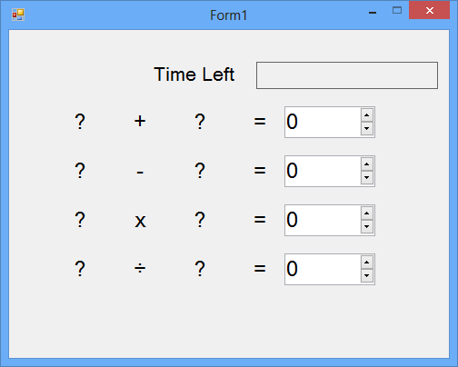

Slide 13
To add a start button and set the tab-index order
Add a Button
(Name)-> startButton.
Text-> Start the quiz.
Font->14.
AutoSize->True
TabIndex->1.
Set TabIndex
sum->2, difference->3, product->4, and quotient ->5.

Slide 14
To create a random addition problem
Add a Random object to your form and named the object randomizer.
public partial class Form1 : Form {
// Create a Random object called randomizer
// to generate random numbers.
Random randomizer = new Random();

Slide 15
Add two integer variables to the form, and name them addend1 and addend2.
// Create a Random object called randomizer
// to generate random numbers.
Random randomizer = new Random();
// These integer variables store the numbers
// for the addition problem.
int addend1;
int addend2;

Slide 16
Add a method that's named StartTheQuiz() and that uses the Random object's Next() method to show the random numbers in the labels.
StartTheQuiz() will eventually fill in all of the problems and then start the timer.

Slide 17
public void StartTheQuiz() {
addend1 = randomizer.Next(51);
addend2 = randomizer.Next(51);
plusLeftLabel.Text = addend1.ToString(); plusRightLabel.Text = addend2.ToString();
sum.Value = 0;
}

Slide 18
Double-click the Start button
private void startButton_Click(object sender, EventArgs e) {
StartTheQuiz();
startButton.Enabled = false;
}

Slide 19
To add a countdown timer
Add an integer variable that's named timeLeft
public partial class Form1 : Form {
randomizer = new Random();
int addend1;
int addend2;
int timeLeft;

Slide 20
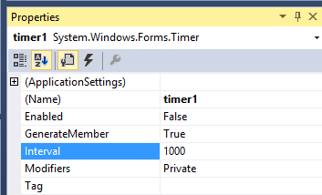
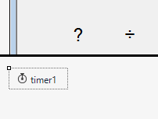
Add Timer
Choose the timer1 icon that you just added, and set its Interval property to 1000.
On the form, double-click the Timer control, or choose it and then choose the Enter key.

Slide 21
private void timer1_Tick(object sender, EventArgs e) {
if (timeLeft > 0) {
label. timeLeft = timeLeft - 1;
timeLabel.Text = timeLeft + " seconds";
} else {
// If the user ran out of time, stop the timer, show
// a MessageBox, and fill in the answers.
timer1.Stop();
timeLabel.Text = "Time's up!"; MessageBox.Show("You didn't finish in time.", "Sorry!"); sum.Value = addend1 + addend2; startButton.Enabled = true; }
}

Slide 22
Add three lines to the end of the StartTheQuiz() method
timeLeft = 30;
timeLabel.Text = "30 seconds";
timer1.Start();

Slide 23
Add the CheckTheAnswer() method.
private bool CheckTheAnswer() {
if (addend1 + addend2 == sum.Value) return true;
else
return false; }

Slide 24
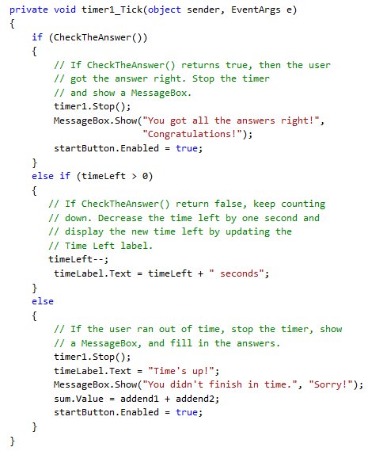

Slide 25
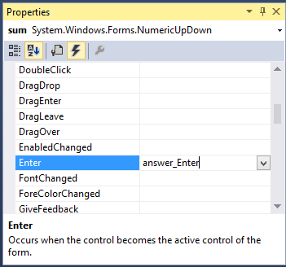
To add an Enter event handler for a NumericUpDown control
Choose the first NumericUpDown control (named "sum"), and then, in the Properties dialog box, choose the Events icon on the toolbar.
Choose the Enter event, enter answer_Enter, and then choose the Enter key.

Slide 26
private void answer_Enter(object sender, EventArgs e) {
// Select the whole answer in the NumericUpDown control.
NumericUpDown answerBox = sender as NumericUpDown;
if (answerBox != null) {
int lengthOfAnswer = answerBox.Value.ToString().Length;
answerBox.Select(0, lengthOfAnswer);
}
}

Slide 27
Your task
Add code of multiplication and dividion

