Slide 1
Clustering
Chumphol Bunkhumpornpat
Department of Computer Science
Faculty of Science
Chiang Mai University

Slide 2
Learning Objectives
What is clustering?
Understand the elements involved in evaluation of classifiers
K-means
DBSCAN

Slide 3
Supervised vs. Unsupervised
Supervised learning uses labeled input and output data, while an unsupervised learning algorithm does not.

Slide 4
Clustering

Slide 5
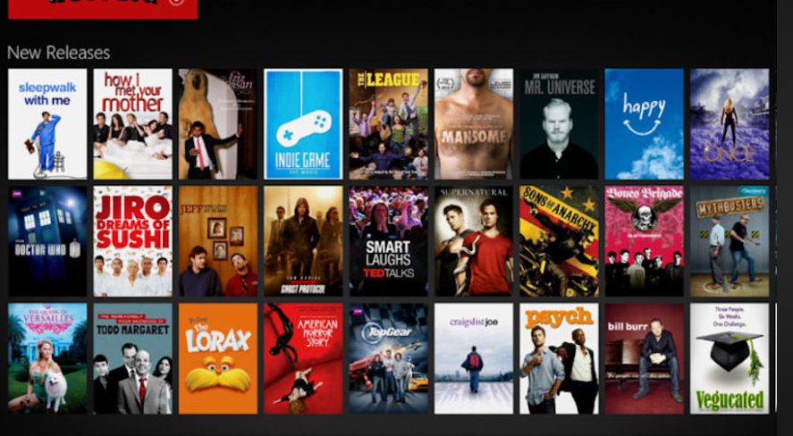
Netflix-Movies-and-TV-Shows-Clustering

Slide 6
Patterns in the Same Cluster
Intra-cluster: Small
Similarity: High
Dissimilarity: Low

Slide 7
Patterns in Different Clusters
Inter-cluster: Large
Similarity: Low
Dissimilarity: High

Slide 8
The Input-Output Behavior of Clustering

Slide 9
A Two-Dimensional Data Set of 10 Vectors

Slide 10
The ij^{th} Entry in the Matrix is the Distance Between X_{i} and X_{j} (Threshold = 5).

Slide 11
The K-Means Clustering Method
Given k, the k-means algorithm is implemented in four steps:
Partition objects into k nonempty subsets
Compute seed points as the centroids of the clusters of the current partitioning (the centroid is the center, i.e., mean point, of the cluster)
Assign each object to the cluster with the nearest seed point
Go back to Step 2, stop when the assignment does not change

Slide 12
An Example of K-Means Clustering
K=2
Arbitrarily partition objects into k groups
Update the cluster centroids
The initial data set
Loop if needed
Reassign objects
Partition objects into k nonempty subsets
Repeat
Compute centroid (i.e., mean point) for each partition
Assign each object to the cluster of its nearest centroid
Until no change
Update the cluster centroids

Slide 13
K-Means Limitation
What would you get from K-Means on this dataset ?

Slide 14
Result from K-Means
Is it good ?

Slide 15
Density-based Clustering
Clustering based on density such as density-connected points
Features
Discover clusters of arbitrary shape
Handle noise
Example algorithm
DBSCAN

Slide 16
Result from DBSCAN

Slide 17
DBSCAN

Slide 18
Eps-Neighbourhood
Eps
MinPts = 5
Eps
Border Instances
Core Instances

Slide 19
Eps and MinPts
If the instance has at least MinPts neighbourhood within the radius Eps, the instance will be a core instance.
But if not, the instance will be a border instance

Slide 20
Directly Density Reachable

Slide 21
Density Connected

Slide 22
DBSCAN Concepts
p₂ is directly density reachable from p₁ if p₂ is Eps-neighbourhood of p₁ and p₁ is a core instance.
p₀ and p_{n} are density connected, if there is a sequence of directly density reachable instances between p₀ and p_{n}.
A cluster is a set of density connected instances
Noise is a set of instances which are not located in any clusters.

Slide 23
Reference
Murty, M. N., Devi, V. S.: Pattern Recognition: An Algorithmic Approach (Undergraduate Topics in Computer Science). Springer (2012)
Han, J., Kamber, M., Pei, J.: Data Mining: Concepts and Techniques, 3rd Edition. Morgan Kaufman (2011)

Slide 24
Picture Credit
https://github.com/apoorvaKR12695/Netflix-Movies-and-TV-Shows-Clustering
http://www.hypertextbookshop.com/dataminingbook/public_version/contents/chapters/chapter004/section004/blue/page003.html
http://www.inf.unibz.it/dis/teaching/msc/project-dbscan.html

