Slide 1
Ch. 1: Computer System
Benjamas Panyangam
2013 Revision by Suphakit Awiphan Ph.D. Adapted for English Section by Kittipitch Kuptavanich
And Prakarn Unachak
Department of Computer Science, Faculty of Science, Chiang Mai University

Slide 2
Chapter 1 Computer System
Computer Classification
Data Representation in Computer System
Components of Computer System
Hardware
Software
Peopleware

Slide 3
Computer Classification
Classified by data handling
Classified by work purposes
Classified by size

Slide 4
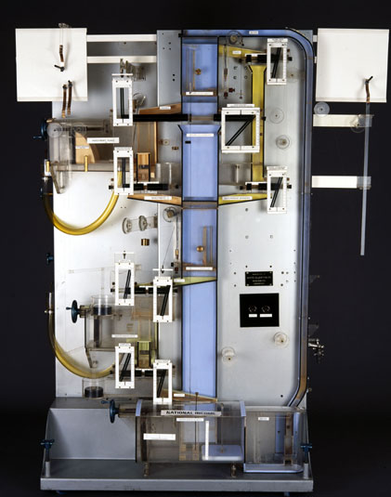
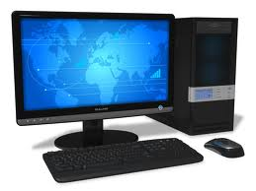
Classified by data handling
1. Analog Computer
continuous (approximate) values
real time processing
2. Digital Computer
Discrete Value
Data are represented as 0 and 1
More accuracy than analog computer
Phillips Hydraulic Computer
Personal Computer
Ref: http://www.itsavvy.in/computer-classification

Slide 5
Classified by data handling (cont.)
Another example of analog computer
Unusual example of digital computer
https://www.youtube.com/watch?v=jiRgdaknJCg
Slide Rule (source: MIT)

Slide 6
Classified by data handling
3. Hybrid Computer
A merge between an analog computer and a digital Computer
Uses Converter b/w analog and digital
Ref: http://www.itsavvy.in/computer-classification

Slide 7
Classified by work purposes
1. General Purpose Computer
Desktop computer, notebook computer, mobile devices
2. Special Purpose Computer
Embedded Computer
Elevator, washing machine, car
Ref: http://sethf.com/infothought/blog/archives/000042.html

Slide 8
Classified by Capacity
1. Embedded Computer
2. Microcomputer, Personal Computer
3. Workstation, Server
4. Mainframe
5. Supercomputer

Slide 9
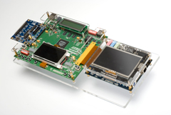
Embedded Computer
Computers that are a part of a machine or device
Execute a program that is stored in non-volatile memory

Slide 10
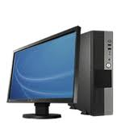
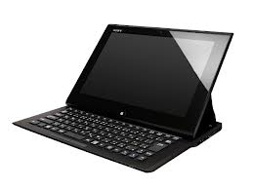
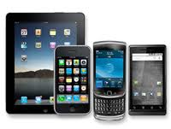
Microcomputer, Personal Computer
Microcomputers are the most common type of computers used by people today
Desktop computers, Notebook computers, Game consoles, Mobile devices

Slide 11
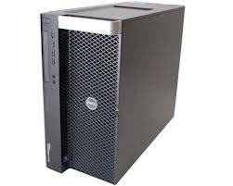
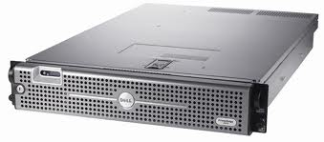
Workstation
High-end microcomputer designed for technical or scientific applications.
They are optimized for the visualization and manipulation of different types of complex data and also multitasking
3D mechanical design, engineering simulation , (e.g. computational fluid dynamics), animation and rendering of images, and mathematical plots

Slide 12
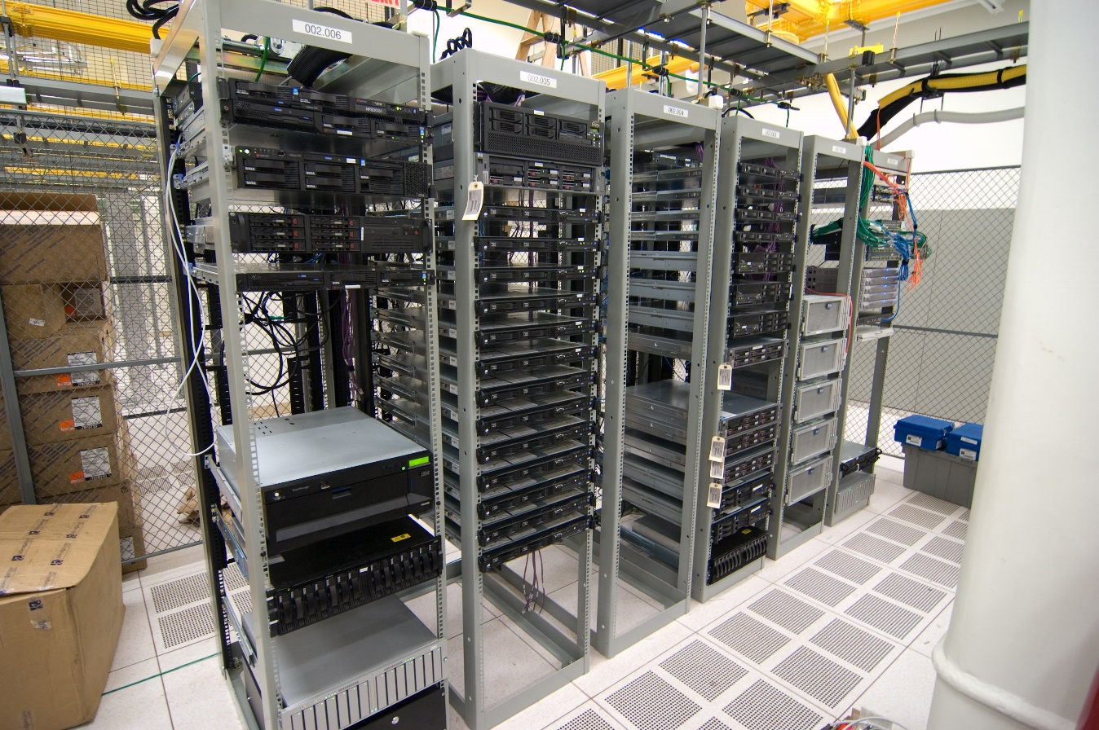
Server
Powerful computer that performs certain service (request) for client computer.
File Server
Game Server
Mail Server
Web Server

Slide 13
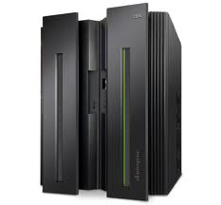
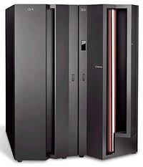
Mainframe
High reliability and security
Emphasizes on reliable of transactions
High hardware and computational utilization rates to support massive throughput (very large number of transaction)
Example: transactions for bank.
Run uninterrupted for long periods of time.

Slide 14
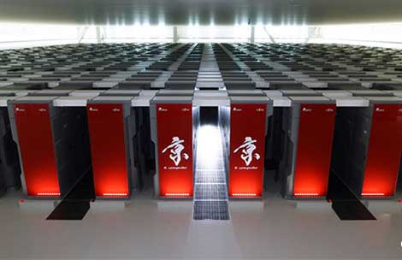
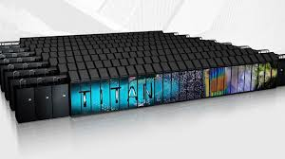
Supercomputer
Emphasizes on speed of calculation
Scientific and engineering problems (high-performance computing) with high precision
Fujitsu K Computer, @Kobe, Japan
Cray Titan, @Oak Ridge, USA

Slide 15
Data representation in Computer System

Slide 16
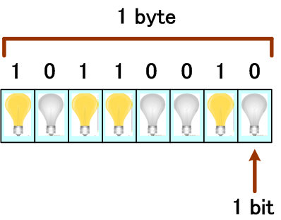
Data representation in Computer System
Bit is the basic unit of information in computing and digital communications (value of 0 or 1)
Byte unit of information most commonly consists of eight bits. Historically, the byte was the number of bits used to encode a single character of text in a computer.

Slide 17
Data representation in Computer System
ASCII Character Code
Binary | Decimal | Character
0010 1010 | 42 | *
0010 1011 | 43 | +
0011 0001 | 49 | 1
0011 0010 | 50 | 2
0100 0001 | 65 | A
0100 0010 | 66 | B
0100 0011 | 67 | C
0100 0100 | 68 | D
Bit – Byte examples
0 | 1 bit
1 | 1 bit
1011 | 4 bit
10100011 | 8 bit or 1 byte
Binary = base 2 Decimal = base 10

Slide 18
Other Character Encodings
Unicode
Use additional bytes to encode non-ASCII characters
For example U+2F08 = ⼈
2F08₁₆ is a hexadecimal number
GB 2312
For Chinese Characters
Shift JIS
For Japanese

Slide 19
Data Capacity
1 Kilobyte (KB) | = | 1024 Bytes (2¹⁰ Bytes)
1 Megabyte (MB) | = | 1024 Kilobytes
1 Gigabyte (GB) | = | 1024 Megabytes
1 Terabyte (TB) | = | 1024 Gigabytes
1 Petabyte (PB) | = | 1024 Terabytes

Slide 20
Components of computer system
Hardware
Software
Peopleware

Slide 21
Hardware
The collection of physical elements that constitute a computer system
Input Unit
Central Processing Unit
Output Unit
Memory, Storage
Primary Storage, Main Memory
Secondary Storage

Slide 22
Computer Hardware
Video Card

Slide 23
Computer Components

Slide 24
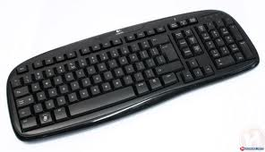
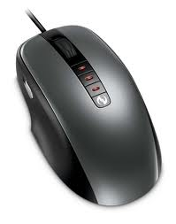
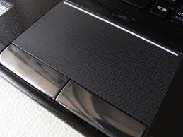
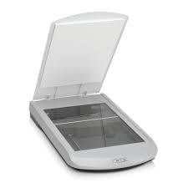
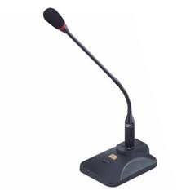
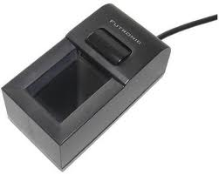
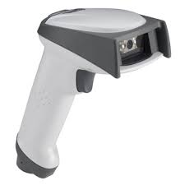
Input Units
Keyboard
Mouse
Touch pad
Scanner
Microphone
Fingerprint reader
Barcode reader

Slide 25
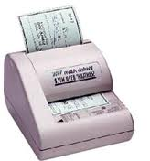
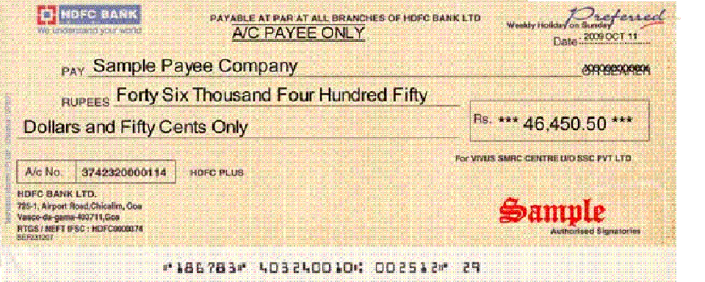
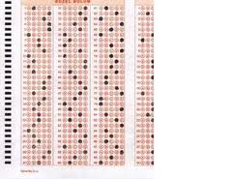
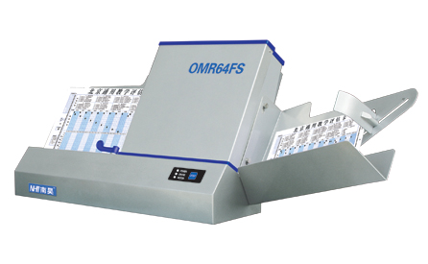
Input Units
Magnetic Ink Character Recognition: MICR
Optical Mark Reader: OMR

Slide 26
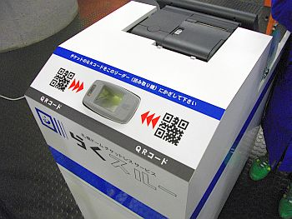
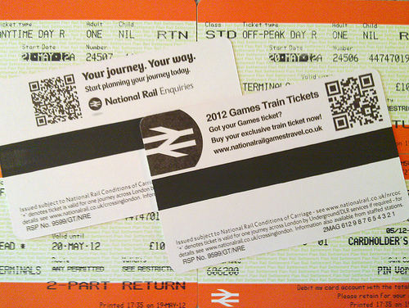
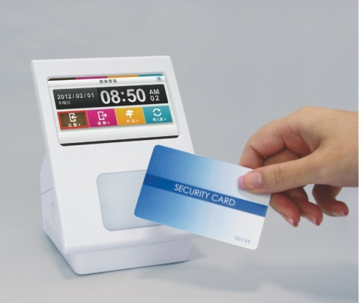
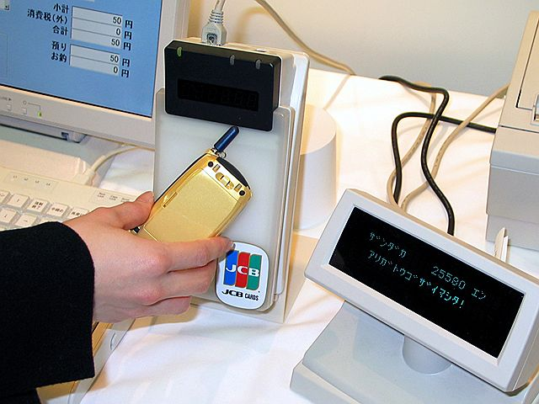
Input Units
QR code reader
Contactless smart card reader

Slide 27
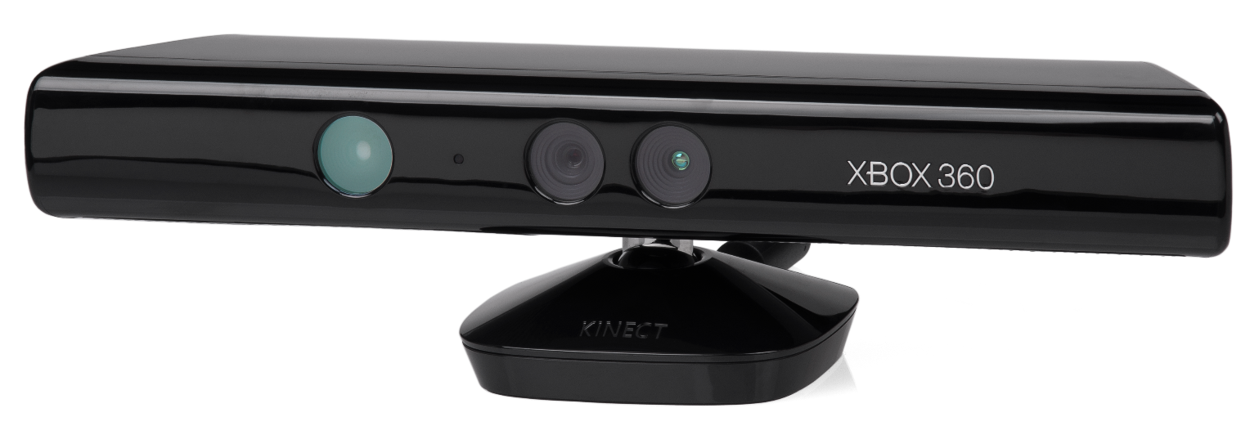
Other Input Units
Motion sensing
Input with your mind
https://www.youtube.com/watch?v=ogBX18maUiM

Slide 28
Central Processing Unit
Central Processing Unit (CPU)
The hardware within a computer that carries out the instructions of a computer program
Performing the basic
arithmetical,
logical, and
input/output
Microprocessor
More than one processor in a chip, multiprocessor.

Slide 29
Central Processing Unit
CU: Control Unit
Extracts instructions from memory and decodes and executes them calling on the ALU when necessary
ALU: Arithmetic Logic Unit
Performs arithmetic and logical operations

Slide 30
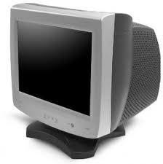
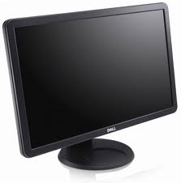
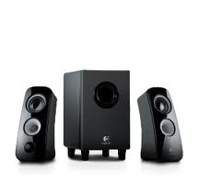
Output Unit
Soft Copy
Monitor
Cathode Ray Tube (CRT)
Liquid Crystal Display (LCD)
Speaker

Slide 31
Output Unit

Slide 32
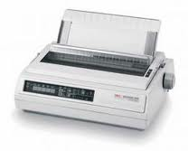
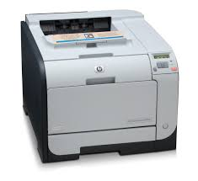
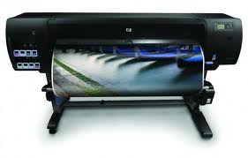
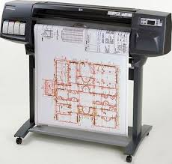
Output Unit
Hard Copy
Printer
Impact Printer : Dot matrix printer
Non-impact Printer : Laser, Inkjet printer
Plotter

Slide 33
Memory or Storage Unit
Primary / Main Memory
ROM: Read Only Memory
RAM: Random Access Memory
Secondary Memory
SAS: Sequential Access Storage
DAS: Direct Access Storage

Slide 34
Primary / Main Memory
ROM (Read Only Memory)
Read Only (sort of)
Non-volatile (Requires no power to maintain data)
RAM (Random Access Memory)
Allows stored data to be accessed directly in any random order.
Store data and instruction temporarily to be calculated by CPU
Volatile (Requires power to maintain data)

Slide 35
SAS: Sequential Access Storage
A class of data storage devices that read their data in sequence.
Slower access to non serial data.
Examples
Paper Tape
Punch Card
Magnetic Tape

Slide 36
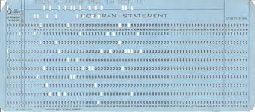
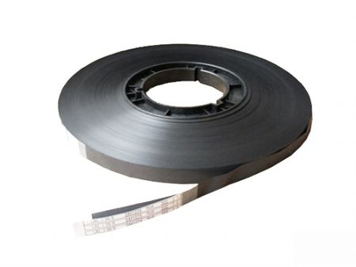
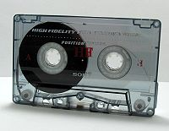
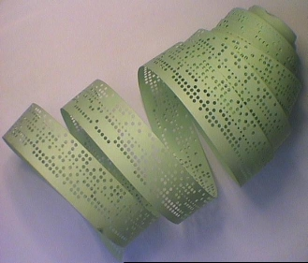
SAS: Sequential Access Storage
Punch Card
Magnetic Tape
Paper Tape

Slide 37
DAS: Direct Access Storage
Relatively low access time relative to its capacity
The access methods: Sequential, Indexed and Direct.
Magnetic
Hard Disk
Diskette or Floppy Disk
Optical
Compact Disc (CD)
Digital Versatile Disc (DVD)
Blu-ray Disc (BD)
Solid State
USB Flash Drive
Solid State Drive (SSD)

Slide 38
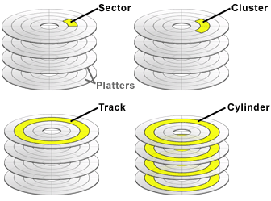
Magnetic Disk Details
Sector: smallest unit of data that can be read or written from a disk. Typically, sectors are 512 bytes in size, but other sizes including 1024 and 2048 are common.
Cluster: A cluster is the smallest unit of data that a file system can allocate for a file. (e.g. 512 – 4,096 bytes for NTFS)
Track: A track is a concentric ring of sectors on a platter.
Cylinder: A cylinder is a group of tracks in all the platters
Ref: http://www.sweetscape.com/010editor/manual/EditingDrives.htm

Slide 39
CD and DVD
The data is stored on the disc with a laser or stamping machine, and can be accessed when the data path is illuminated with a laser while spinning.
CD storage capacity: 650 – 870 MB
DVD storage capacity: 4.7 – 17 GB
CD-ROM
CD-R
CD-RW
DVD-ROM
DVD-R
DVD+R
DVD-RW
DVD+RW
DVD-RAM

Slide 40
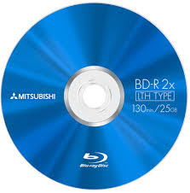
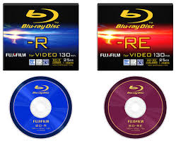
Blu-ray Disc
Optical disc storage medium designed to supersede the DVD format.
Blu-ray Disc uses a 405 nm "blue" laser diode.
Single layer: 25 GB
Double layer: 50 GB
Triple layer (BDXL): 100 GB
BD-R (Blu-ray Disc Recordable)
BD-RE (Blu-ray Disc Rewritable)

Slide 41
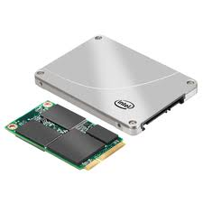
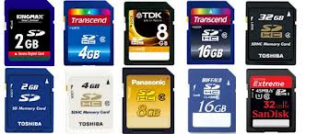
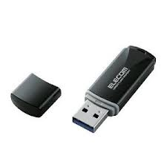
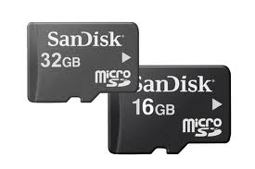
Solid State Storage
No Moving part
Faster as data can be retrieved directly from various locations
More expensive per unit of storage than HDDs.
i.e. USB Memory, SD Card, Solid State Drive (SSD)

Slide 42
A Motherboard (Mainboard)
The Motherboard is the primary circuit board of a personal computer containing the circuitry for the central processing unit, keyboard, mouse and monitor, together with slots for other devices.

Slide 43
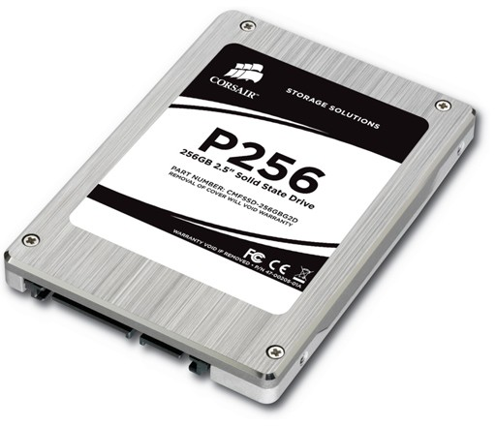
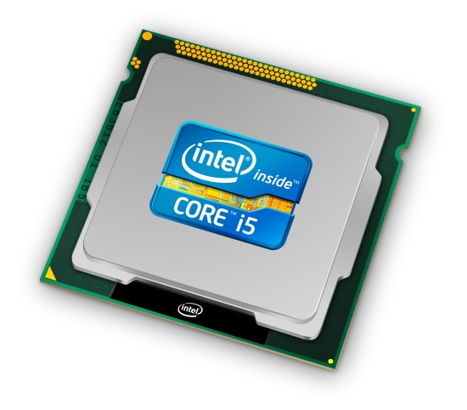
RAM and HDD

Slide 44
Software

Slide 45
Software
Computer software, or just software, is any set of machine-readable instructions (most often in the form of a computer program) that directs a computer's processor to perform specific operations.

Slide 46
Software Classification
Application Software
“What users directly want out of computers”
Special Purpose Software
Package Software
System Software
“What helps application software works”
Operating System
(Programming) Language Translator
Utility Software

Slide 47
Programming Language
A programming language is an artificial language designed to communicate instructions to a machine, particularly a computer.
Programming language generations
Machine Language
Assembly Language
High-level Language
Very High-level Language
Natural Language
Ref: http://www.webopedia.com/TERM/F/fourth_generation_language.html

Slide 48
Machine Language: 1st Generation (1GLs)
In binary form (digital code).
11110000 11000111
The only language which CPU (Machine) can execute (understand),
Referring to any memory location in RAM.
Using very detailed instructions.
Machine(CPU) Dependent

Slide 49
Assembly Language: 2GLs
A symbolic language. A group of binary code equals one symbol
Symbolic programming language
Translated into machine language by an Assembler
Assembly Language
Load CL with 55 decimal (37 hex)
Machine Language
Notes:
37hex = 16 * 3 + 7 = 55

Slide 50
Example of Assembly Language Code
source: http://cssimplified.com/

Slide 51
High Level Language: 3GLs
Meaningful language and more programmer-friendly.
it may use natural language elements
e.g. include, case, do, if, else, for, goto
To be translated by a Compiler or an Interpreter
For example, FORTRAN, BASIC, Pascal, C, Java

Slide 52
Example of 3GL Code: C++
#include <iostream>
int main()
{
std::cout << "Hello, world!\n";
}

Slide 53
Very High Level Language: 4GLs
Designed to reduce
programming effort
the time it takes to develop software,
and the cost of software development.
User specify what needs to be done without having to specify how it is to be done
For example, Python, Ruby, SQL

Slide 54
Example of 4GL Code: Python
print “Hello, World!”

Slide 55
4GL Example – SQL Query
SELECT MONTH, DAYLIGHT, TEMP
FROM STATS
ORDER BY TEMP DESC;
“Pick MONTH, DAYLIGHT, and TEMP data from table STATS, sorting them in descending order”

Slide 56
Translator
Program translator translates source code of programming language into machine language-instruction code
1. Assembler
An assembler translates the symbolic codes of programs of an assembly language into machine language instructions

Slide 57
Translator
2. Interpreter
Interpreter directly executes the program from its source code. Due to this, every time the source code should be inputted to the interpreter. In other words, each line is converted into the object codes.
3. Compiler
Compilers are the translators, which translate all the instructions of the program into machine codes, which can be used again and again
Ref: http://my.safaribooksonline.com/book/programming/c/9788131760314/basics-and-introduction-to-c/section_1.7

Slide 58
System Software
Software designed to operate the computer hardware and to provide a platform for running application software
Utility Software
small, powerful programs with a limited capability, they are usually operated by the user to maintain a smooth running of the computer system
e.g. Anti-virus software, Backup software, Disk defragmenter, File manager, Network utility

Slide 59
System Software
Operating System
a collection of software that manages computer hardware resources
Provides common services for computer programs.
The operating system acts as an intermediary between programs and the computer hardware
For example, Microsoft Windows, OS X, Solaris, Linux

Slide 60
Application Software
Application software is all the computer software that causes a computer to perform useful tasks
Special Purpose Software
Special Purpose application software is very specific in its use for example engineering related application.
Package Software
A collection of computer programs —usually application software or programming software— of related functionality
For example MS office Suite

Slide 61
source: macworld
source: wikipedia
source: play.google.com
source: mspoweruser

Slide 62
Peopleware

Slide 63
Peopleware
Peopleware can refer to anything that has to do with the role of people in the development or use of computer software and hardware systems
Peopleware classification
Administrative staff
Technical staff
Operational staff

Slide 64
Peopleware
Administrative Staff
Manage resources to maximize benefits to the organization
Determine planning & standards within the organization
Example
Manager
Chief Officer

Slide 65
Peopleware
Example of Administrative Staffs
Chief Information Officer (CIO)
Manage IT in an organization (purchase, planning, organizing, etc.)
Chief Technology/Technical Officer (CTO)
Managing technologies in an organization, including developing new ones.

Slide 66
Peopleware
Technical staff
Use technical knowledge to analyze, design, create, and maintain computer system.
Responsibilities
System Analysis & Design
Problem Solving
Program Design and Coding
Technical Support
Example:
System Analyst
Programmer
Software Engineer
Network Administrator
Computer Technician

Slide 67
Peopleware
Operational staff
Uses provided software or packages
Technical knowledge not required
Perform non-technical tasks in an organization
User / End User
Computer Operator
Data Entry Operator

