Slide 1
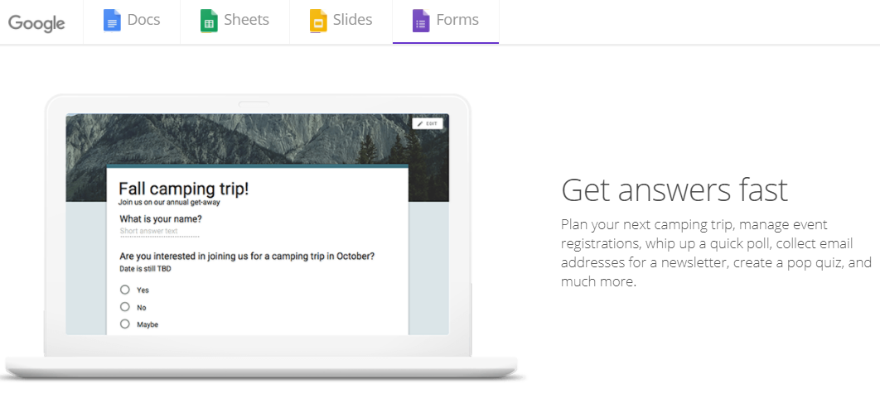
Google Form and Online Questionnaires Creation
เพิ่มภาพตามเนื้อหาของแต่ละบท
Kittipitch Kuptavanich and Dr. Ratsameetip Wita
Adapted into English by Dr. Prakarn Unachak

Slide 2
Google Form
Google Form is an online service from Google. It allows us to create web questionnaires, which let us collect data online quickly. There are many applications for Google Form, such as:
Event Registration/Planning
Feedback
Paperless Form
Polling
Reservation
Survey

Slide 3
Step in Creating Online Survey
Creating a Survey
Adding/Editing Questions
Selecting a Theme
Adding Layout Objects
Distributing the Survey
Get people to be respondents (get them to answer your form)
Distribution medium (URL, Facebook, etc..)
Response Destination: where to store the responses
Viewing the Responses
Spreadsheet
Summary

Slide 4
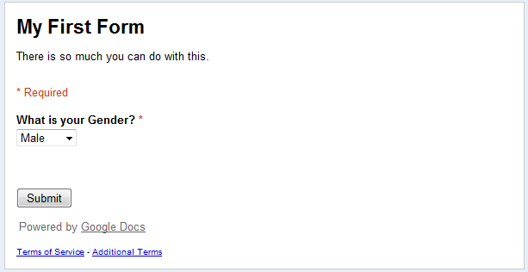
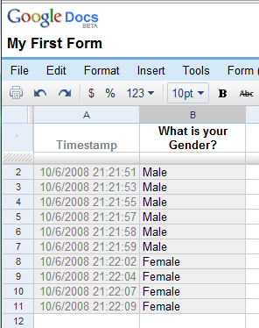
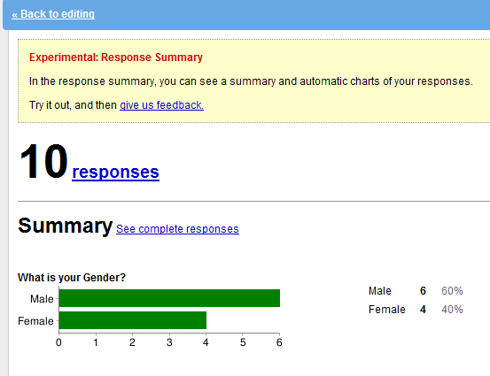
Online Survey with Google Form
1
Create
2
Distribute
3
View Response

Slide 5
Google Docs
Google Form is a part of Google Docs, which is office suites freeware offered by Google
Web Application
Offer services through web browser
https://docs.google.com/
Can access via Google Drive (https://drive.google.com) as well

Slide 6
Applications in Google Docs
Applications in Google Docs Suites
Document
Spreadsheet
Presentation
Form
Drawing

Slide 7
Advantages of Google Docs
Web Application
No extra installation required
Collaboration
Allow multiple people to edit your documents
Access Control
Choose who can edit/view your documents
Offline Mode
Support other Office Suites Files
Documents Downloadable in Multiple formats

Slide 8
Files Formats Supported by Google Docs
Documents: .doc, .docx, .html, plain text (.txt), .rtf
Spreadsheets: .xls, .xlsx, .ods, .csv, .tsv, .txt, .tab
Presentations: .ppt, .pps, .pptx
Drawings: .wmf

Slide 9
Step 1: Creating Online Survey
In Google Docs, a questionnaire (or other documents) can be created two ways:
From Blank Document
From Existing Template
You can view and choose Template at http://drive.google.com/templates
In this lab, we will create a questionnaire from a blank document.

Slide 10
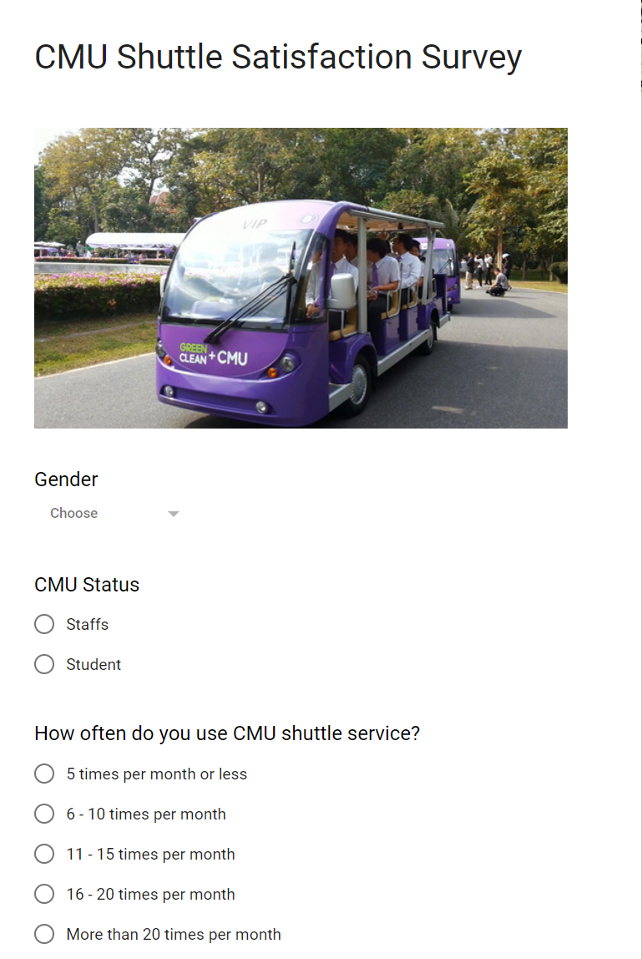
Example of Online Form

Slide 11
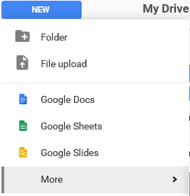
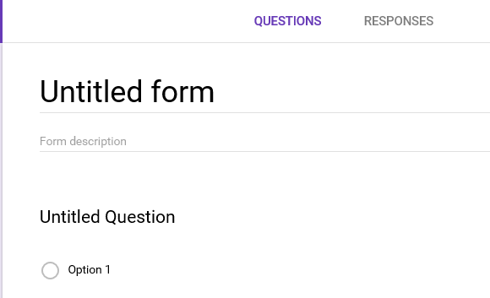
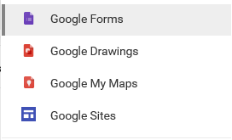
Creating a Google Form Document
You can create a Google form in Google Drive by going to New → More → Google Forms
A form will be created. You need to give it a name.

Slide 12
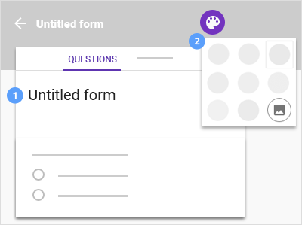
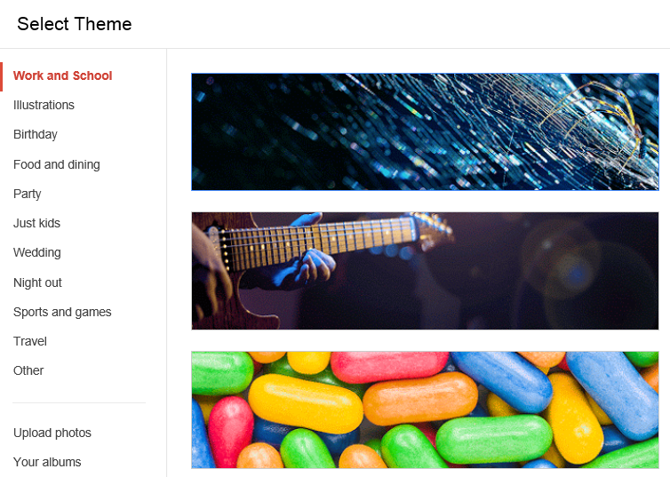
Creating a Google Form Document [2]
You can pick a theme for the form by clicking the Color Palette on the upper right corner of the window.
12

Slide 13
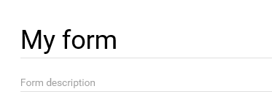
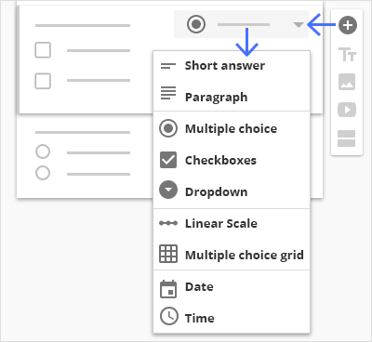
Creating a Google Form Document [3]
You can add a Form Description to tell the respondents the purpose of this form, along with other details.
Then, you can create questions by:
Write question text
Pick Question Types you want for each questions
And, if the selected question types need them, provide choices.

Slide 14
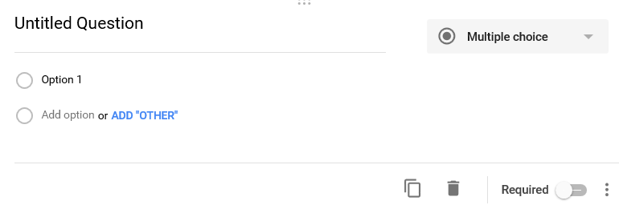
Adding Questions into the Questionnaire
Each question will have the following components
Question text
Type of Question
Duplicate
Delete
Responses
Required question (respondent must answer this question)

Slide 15
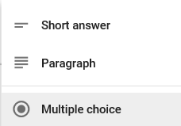
Form Input
In Google Form, you can select the following types of questions.
Short answer: respondent will answer in small text.
Paragraph: respondent can answer in longer text.
Multiple choice: respondent will pick one of the provided answers.

Slide 16
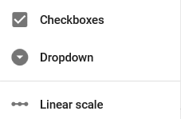
Form Input [2]
Checkboxes: respondent can pick more than one ( ≥ 0) of the provided answers.
Dropdown : respondent will pick one of the provided answers from the pull-down menu.
Linear scale: respondent pick the level of answers in a linear scale. For example, from 1 to 5. You can provide labels to explain the meaning for the values

Slide 17
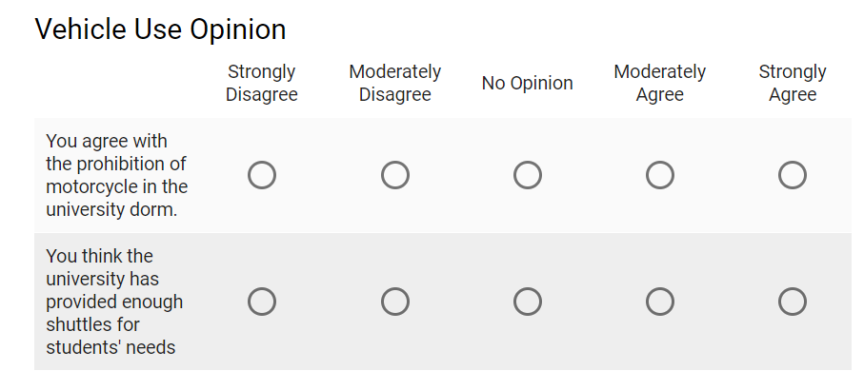
Form Input [3]
Multiple choice grid: respondent will answers a set of question with the same set of answers.
Answers
Questions
Date: respondent will pick a date from the calendar
Time: respondent will pick a time, or a duration

Slide 18
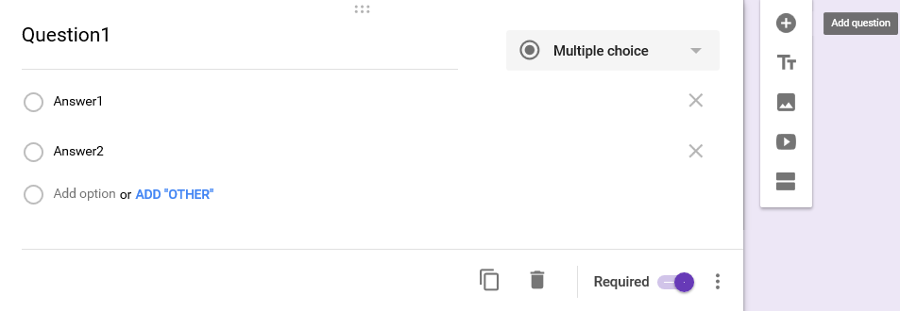
Adding Questions into the Questionnaire [2]
Once you provide the question text, question type, and finish adding the answers, you can add another question by clicking the “Add question” button.

Slide 19
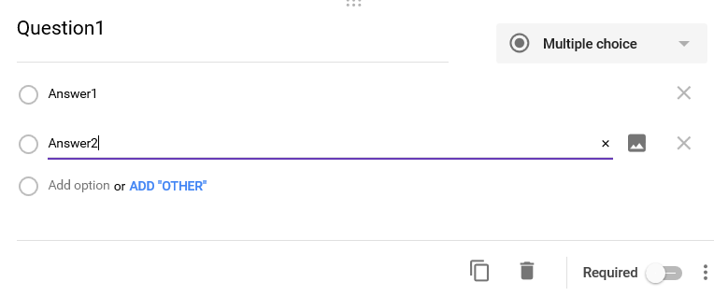
Adding Questions into the Questionnaire [3]
You can also duplicate , delete , and set that the question is a required question (respondent must answers)

Slide 20
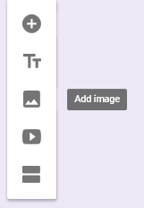
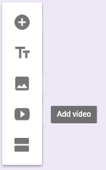
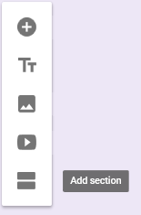
Adding Questions into the Questionnaire [4]
You can also insert image or YouTube video clip.
If you want to divide the form into multiple sections (pages), click the Add section button.

Slide 21
Quiz Mode
You can turn a survey into a quiz
Assign score to questions
Provide correct answer (key) to a question
Grade participants’ responses at the end

Slide 22
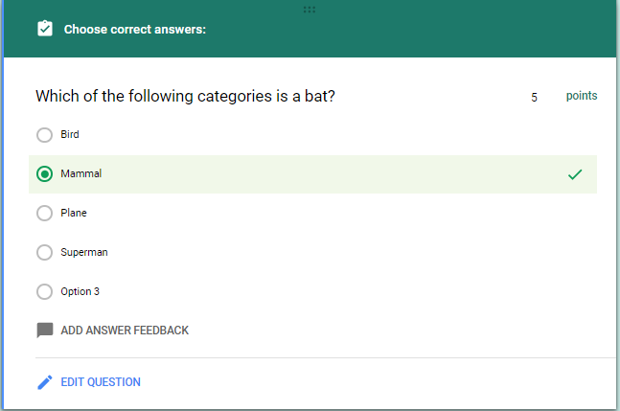
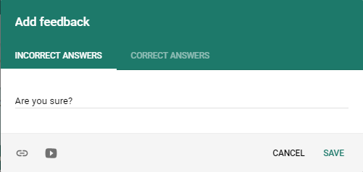
Quiz Mode – Answer Key
Once you turn on the quiz mode, you can make a question into a score question by:
Provide correct answers (keys) to the question
Assign score to the question
[Optional] You can also provide feedback for correct/incorrect answer
1
2
3
1
2
3

Slide 23
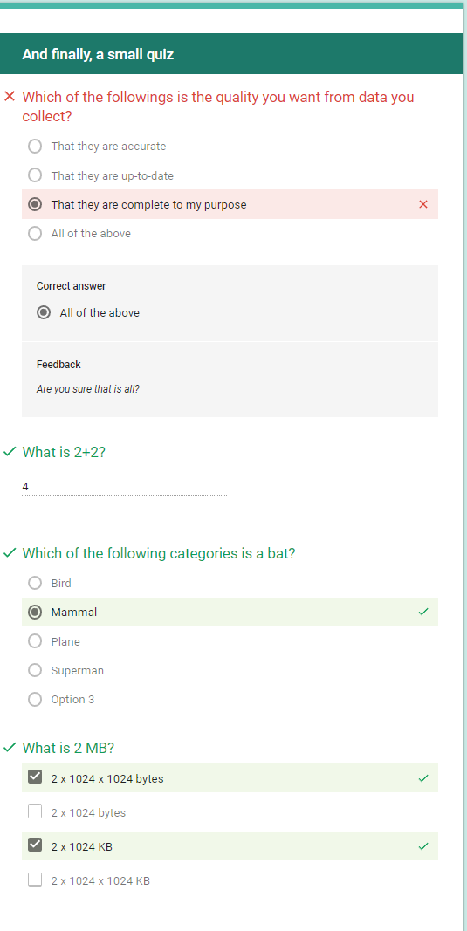
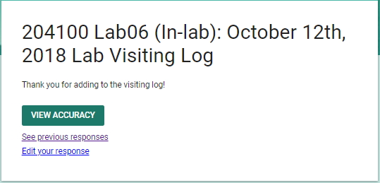
Quiz Mode – Taking a Quiz
Depend on how you set up a quiz, the respondent may be able to see their score/feedback at the end.
Respondent Score will be available in the response spreadsheet as well.

Slide 24
Previewing the Responses
You can see how the respondents will see the form by clicking the Preview button.
In the preview, you also can fill out and submit the responses.

Slide 25
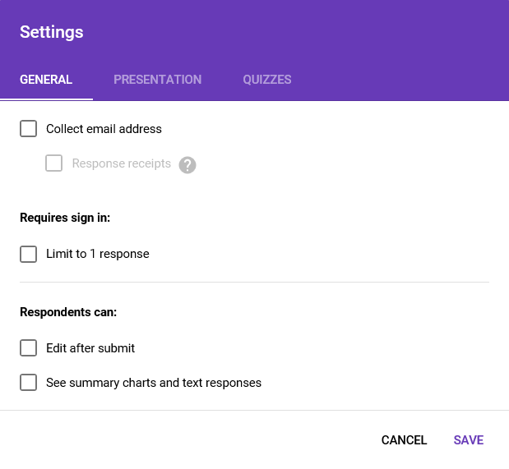
Distributing the Form
Under Setting, there are checkboxes for the following options:
General tab
Limit to one response per Google account.
Respondent can come back and edit the response later. They need to sign into the same Google account.

Slide 26
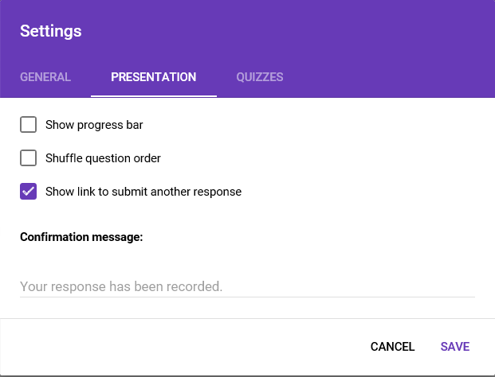
Distributing the Form [2]
Under Presentation tab, there are the following options:
Show how many questions answered/ remained.
Change ordering of questions for each respondents.
Show this message when respondent submit a response.

Slide 27
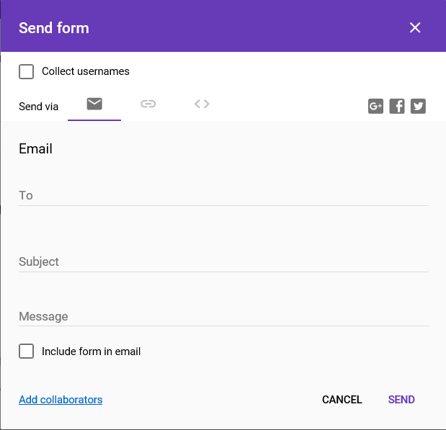
Distributing the Form [3]
When you click the Send button, the Send form window will appear, where you can select how to distribute the form from the following choices:
Email
Social Media
Google+
Facebook
Twitter
Link, a URL will be provided
Embedded HTML

Slide 28
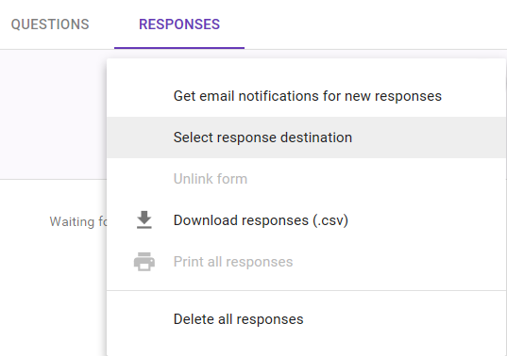
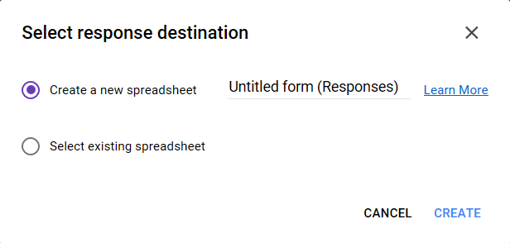
Response Destination
You can select which spreadsheet you want to store the response by clicking Responses → Select response destination
Where you can do the following:
Create a new spreadsheet
Select existing spreadsheet

Slide 29
Accepting/ Not Accepting Responses
If you not longer want to get more responses, you can click the Accepting responses switch to stop accepting the responses.
The switch will be toggled to Not accepting responses where you can provide message to respondents, telling them why you are no longer accept more responses

Slide 30
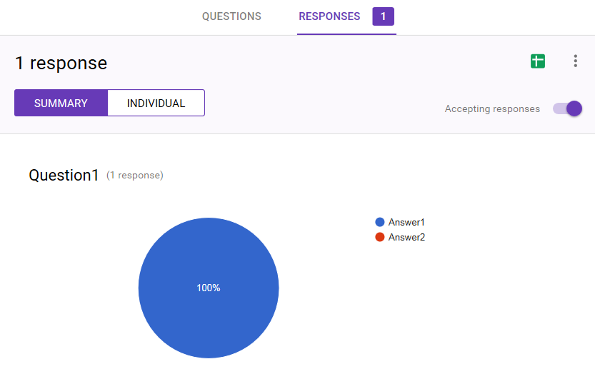
Step 3: Viewing Responses
At the Responses tab, first you will see number of responses.
Clicking on the tab will take you to the summary of responses.

Slide 31
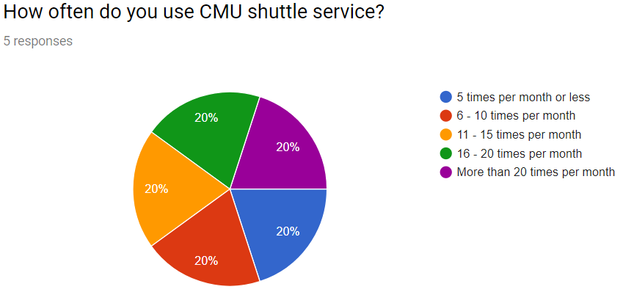
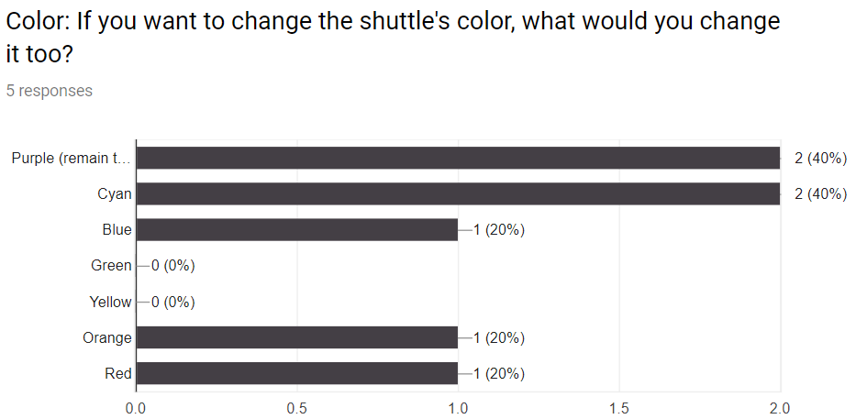
Summary of Responses
Responses will be displayed in chart form. The type of chart depends on the type of question.

Slide 32
Viewing Responses from Spreadsheet
Beside viewing responses through the summary. If we have set the destination of response to spreadsheet, you can view the response spreadsheet by clicking the “View responses in sheet” icon.
The created spreadsheet will have the same name as the form, but with “(Responses)” appended to the name.

Slide 33
Viewing Responses from Spreadsheet [2]
Each row will contain response from one respondent, including a timestamp, denoting when the respondent submit the response.
Each column will contain responses to a question.
If you make a form a quiz, there will be Score column for each response’s quiz score as well.

Slide 34
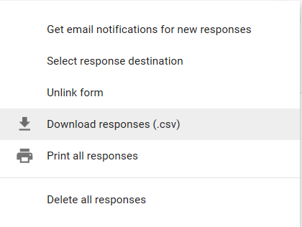
Downloading the Responses from the Spreadsheet
You can also download the responses in the .csv (comma-separated values) format, for further analysis

Slide 35
Summary
What Google Form is
Steps in Creating an Online Questionairre
Creating a Form
Adding/editing questions
Setting response destination
Previewing the form
Distributing the form
Channel of distribution
Accepting/ not accepting responses
Viewing Response
Summary
Spreadsheet

