Slide 1
Internet Security
Written by Thapanapong Rukkanchanunt

Slide 2
Internet Security
Internet Security is the protection of messages communicating within the Internet from theft and forgery
There are two categories of protection
Authentication: Identify the sender/receiver
Authorization: Limit accessibility for individual entities

Slide 3
Authentication
Authentication is an identification process that verifies that a person who wishes to access the data is the real user
There are 3 techniques used in authentication
Possession
Memorization
Physicality

Slide 4
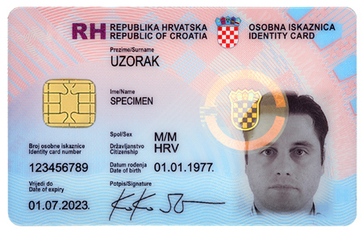
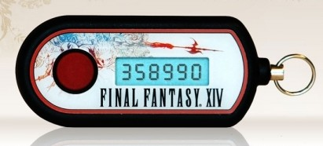
Possession
Use manmade objects to verify the identity such as
ID Card / Credit Card
Authenticator that generates random number with pre-determined seed

Slide 5
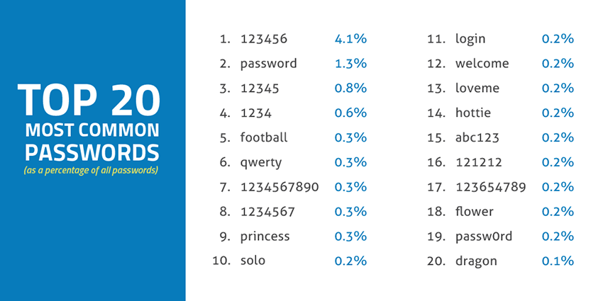
Memorization
Use password

Slide 6
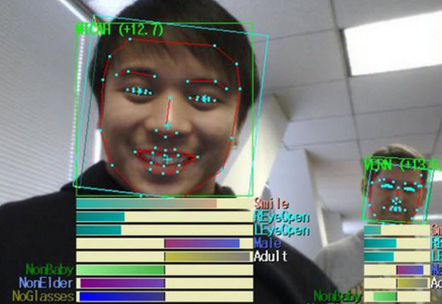
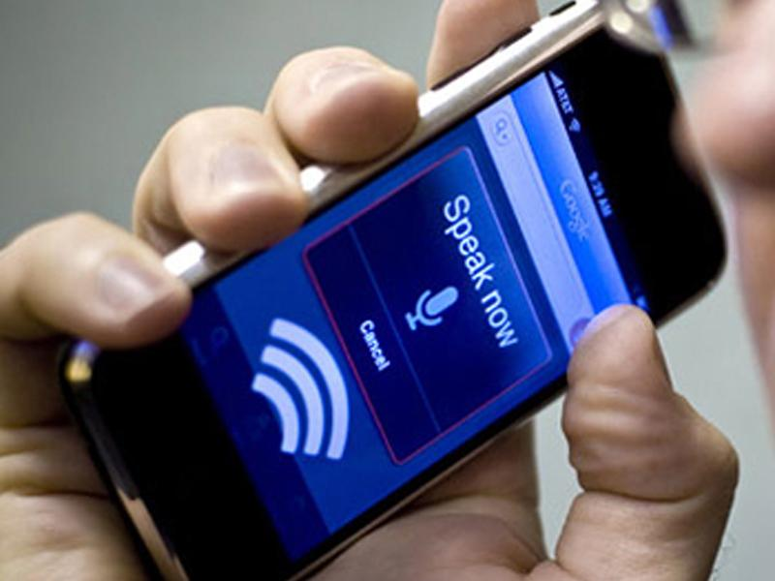
Physicality
Use human physical appearance (dictated by DNA) such as face, eye, fingerprint, palm, voice or a combination of those

Slide 7
Limitation
Limitation of Possession
Theft / Renewable
Forgery / Duplicable
Limitation of Memorization
Easily guessed weak password / Hard-to-memorize strong password
Risk of scamming from public use
Limitation of Physicality
Need special equipment / can be forged (but take effort)

Slide 8
Authorization
Authorization assigns different access permission to different individuals based on their rank or importance
Users of the same rank cannot access each other data
Users with higher rank may be able to see lower rank data but should not be able to modify it without consent from lower rank user
Should Mark Zuckerberg be able to see our relationship status on Facebook while our friends cannot?

Slide 9
Encryption and Decryption
There is no guarantee that our message sent to the Internet cannot be bugged so we need a way to hide our message and make sure that only our friends can reveal it
We use the method called Public Key Cryptography to encrypt our message

Slide 10
Key and Lock analogy
Let’s say that we put our message into a chest
We lock the chest using a KEY
We send the chest to your friend
How would your friend open it?
Message

Slide 11
Twin keys
In real world, we use the same key that locks the chest to open the chest
In the Internet, we can create what is called twin keys
One key can open the chest only if its twin locks the chest
That means that if we lock the chest with one key, that key cannot open the chest

Slide 12
Encryption with twin keys
Alice wants to send a message to Bob
Bob creates twin keys, say gold key and silver key
Bob distributes silver key to everyone

Slide 13
Encryption with twin keys (2)
Alice uses silver key to lock the chest containing her message
Alice sends the locked chest to Bob
Bob opens the lock with gold key and retrieves the message

Slide 14
Why is it safe?
Let’s have our villain named Mallory
Mallory steals the locked chest from Alice
Can Mallory open the chest?

Slide 15
Twin keys creation and their security
Do twin keys really exist? If so, how do one create them?
Twin keys uses concept of Mathematics, specifically number theory
Basically twin keys are two magic numbers that related in some way
Knowing one number cannot help deducing another number
The time to guess gold key using silver key is beyond the age of the universe!!!

Slide 16
Stay safe online
https://www.youtube.com/watch?v=GCWBf7WKYyA

