Slide 1
Computer Science in Everyday Life
Integrated Mathematical Sciences 1/59

Slide 2
Why do we want Computer in our life?
Work is repetitive
Work is tedious
Human is lazy

Slide 3
What is Computer Science?
Computer Science is Science revolving around Data
Computer Science is not just about Programming/Coding
Processing
Collection
Visualization
DATA

Slide 4
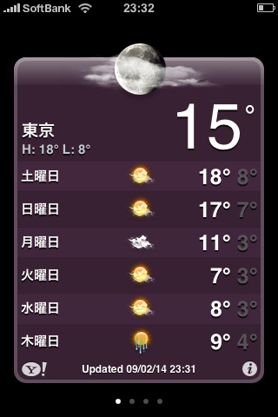
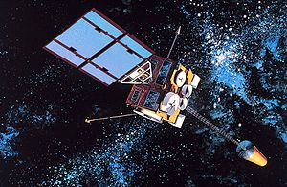
Example of computer usage
Weather Forecast
Parameterized Partial Differential Equations
Input from Satellites
Weather Forecast
Turbulent Diffusion, Radiation, Moist, Heat, …

Slide 5
Computer Technology
There are many topics in Computer Science
Each topic is developed separately but they can be cross-referenced
Technology that we use today is a conjunction of several Computer Science topics

Slide 6
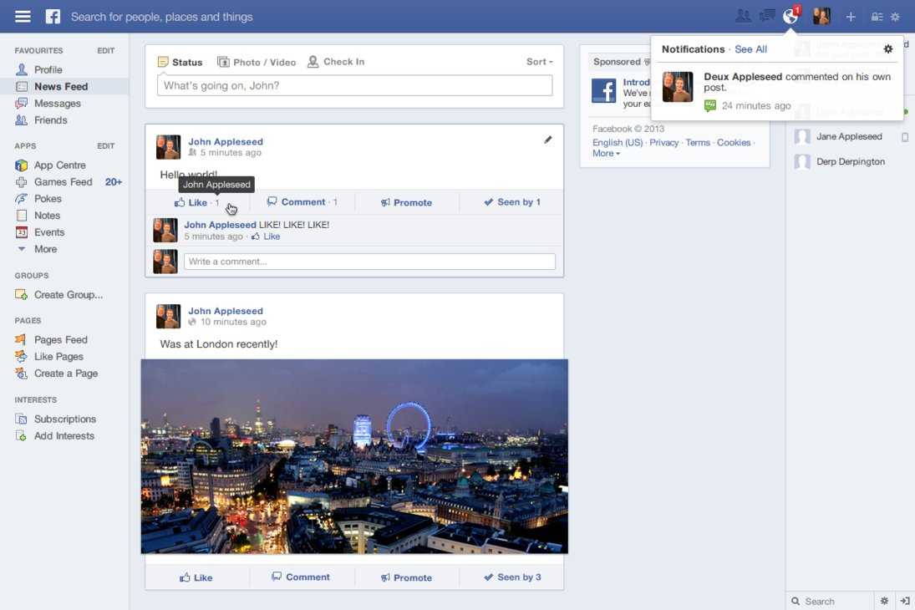
How does Facebook work?
Write a text and click “Post”
Where does this text go?

Slide 7
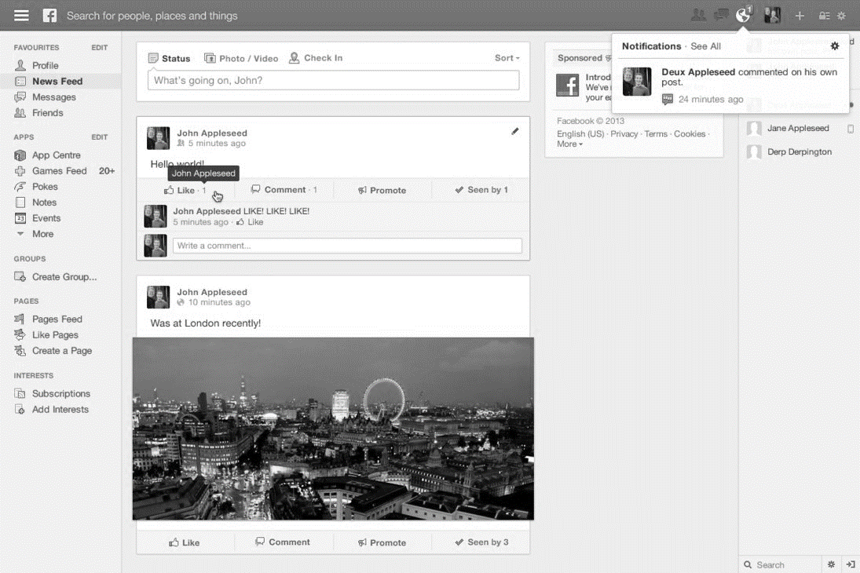
How does Facebook work? (2)
This text goes to Database Server
In fact, all texts around the world go to this Database Server

Slide 8
Database Management System
How to store data efficiently?
How to retrieve data swiftly?
How to maintain data properly?

Slide 9
How does Facebook work? (3)
Are all texts from Database Server displayed on the screen?
How does Facebook sort newsfeed?

Slide 10
Artificial Intelligence
Collect your likes/shares/posts information
Predict your interest based on that information
TEXT 1
Score: 0.7
TEXT 2
Score: 0.9
TEXT 3
Score: 0.5

Slide 11
How does Facebook work? (4)
Are all texts saved on a single Database Server?
If so, where should that server be located?

Slide 12
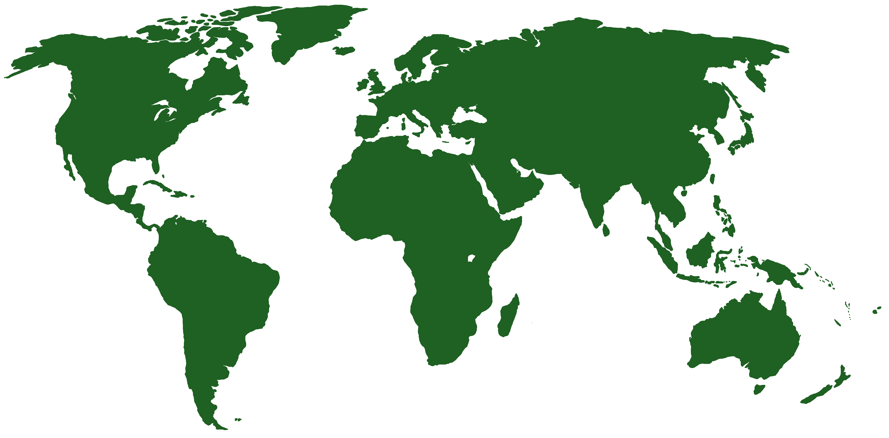
Distributed System
A large number of computers help each other to do the work
Texts are stored in multiple servers across the globe to prevent system failure

Slide 13
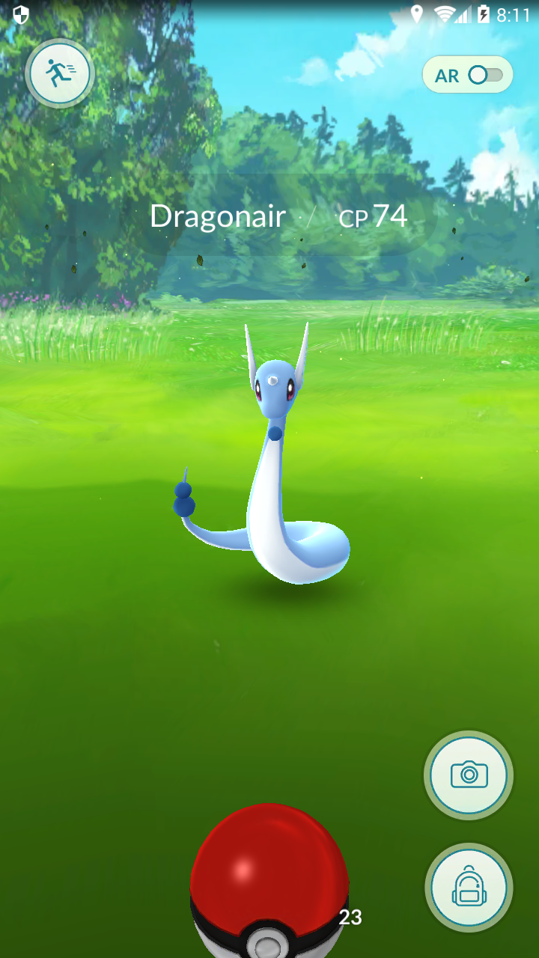
Pokémon Go
How does the game know where you are?
Where does Pokémon come from?

Slide 14
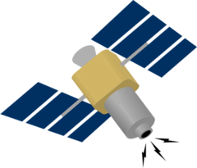
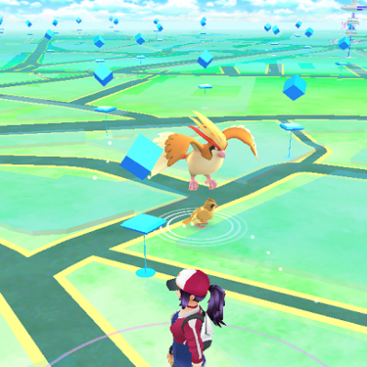
Global Positioning System (GPS)
GPS uses information from satellites network to locate you
Location is given by Latitude, Longitude and Altitude

Slide 15
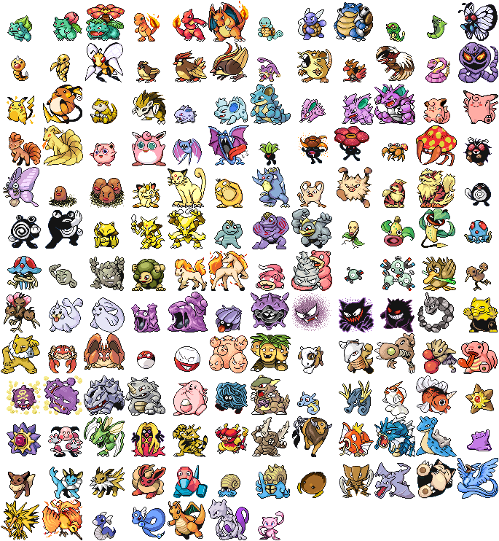
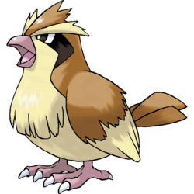
Computer Network
Player sends GPS information to Server
Server sends back Pokémon information
Focus on fast response time to prevent latency
Latitude, Longitude, Altitude

Slide 16
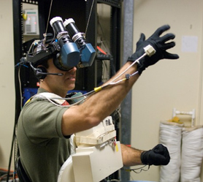
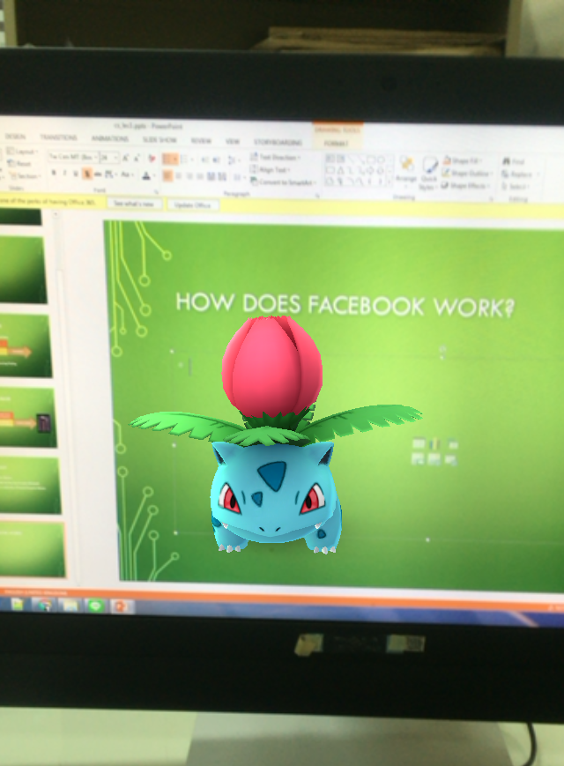
Computer Graphic
Initially create artificial object in artificial world with semi-real physics
Virtual Reality – Bring real person to artificial world via sensors
Augmented Reality – Bring artificial object to the real world via cameras

Slide 17
Computer Security
Encrypt message so no one understand except senders and receivers
Prevent unauthorized access
Detect anomaly activities (virus, malware, Trojan)
b10a8db164e0754105b7a99be72e3fe5
Hello World

Slide 18
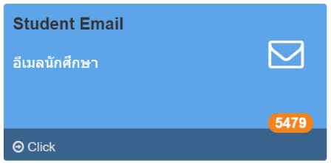
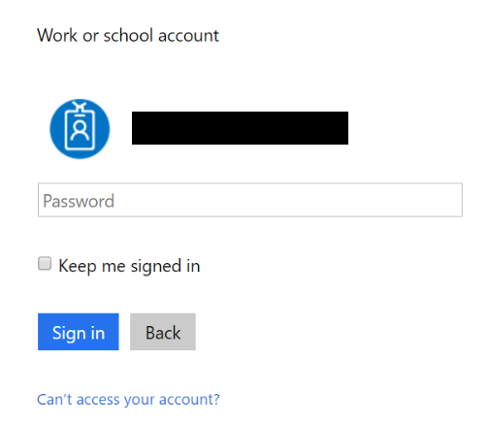
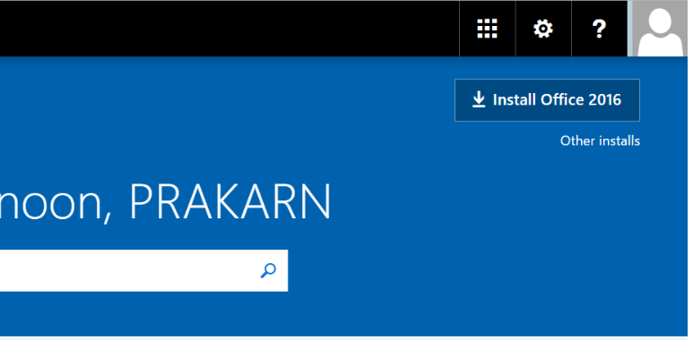
Useful Tools: Microsoft Office
Free for CMU students!!!
Go to https://portal.cmu.ac.th/
Click on “Student Email” and login
Select “Install Office 2016”, save and run the installer
1
2
3

Slide 19
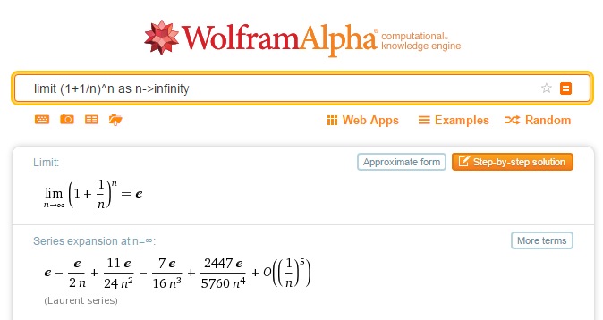
Useful tools: Wolfram Alpha
Go to https://www.wolframalpha.com/
Ask any Math-related problems

Slide 20
Useful tools: Cloud Storage
https://www.dropbox.com/ (2 GB Free)
https://onedrive.live.com/ (5 GB Free)
https://www.google.com/drive/ (15 GB Free)
https://www.box.com/ (10 GB Free)

