Slide 1
History of calculation
Evolution of Computation

Slide 2
Mechanical Era
Slide Rule is the first mechanical device for numeric calculation
Slide Rule can do Multiplication, Division, Power, Root and Trigonometry
Slide Rule works in 2 Steps
Set initial configuration (calibration) between two bars
Read the value on fixed bar that matches the desire value on sliding bar

Slide 3
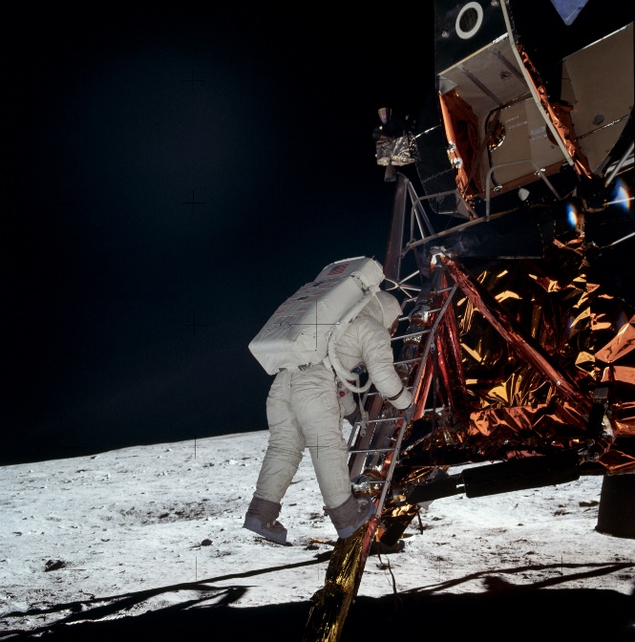
Mechanical Era (2)
What is good about this Slide Rule?
It has visited the moon
Astronauts in Apollo 11 brought Slide Rule during the trip to the moon in 1969

Slide 4
Limitation of Mechanical Devices
Although they are fast (such as Abacus), they lack some basic things of computer
No memory
Not customizable
Require human (remember that we are lazy!!!)

Slide 5
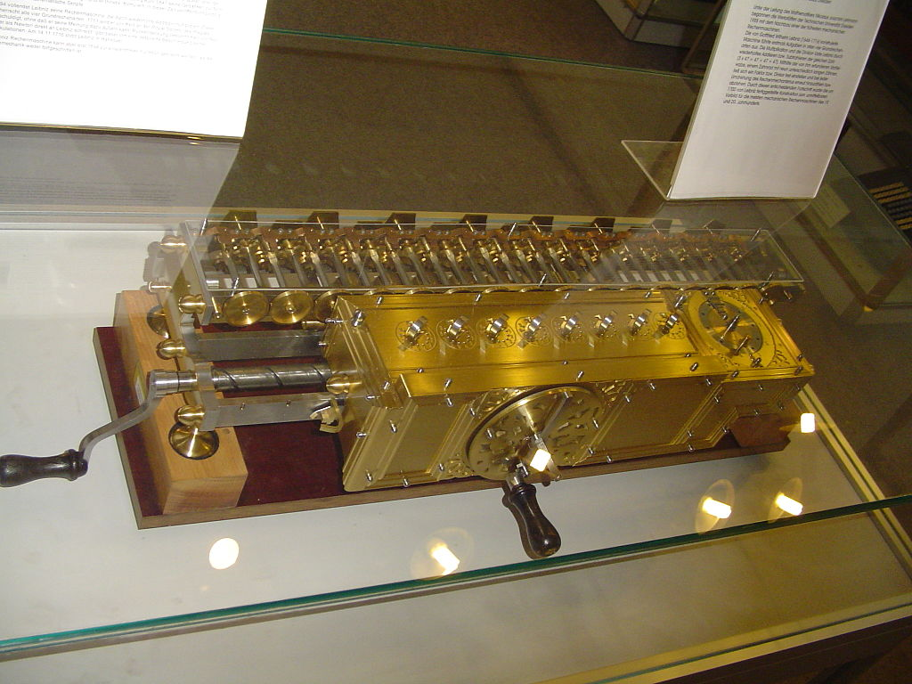
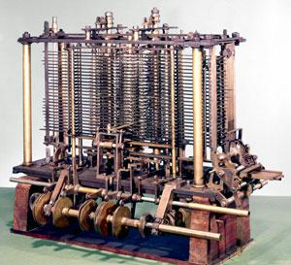
Pre-World War 2 Era
Transition from small mechanical device to a (very) large machine that consisted of several moving parts
They are very fast and powerful but require a physical space

Slide 6
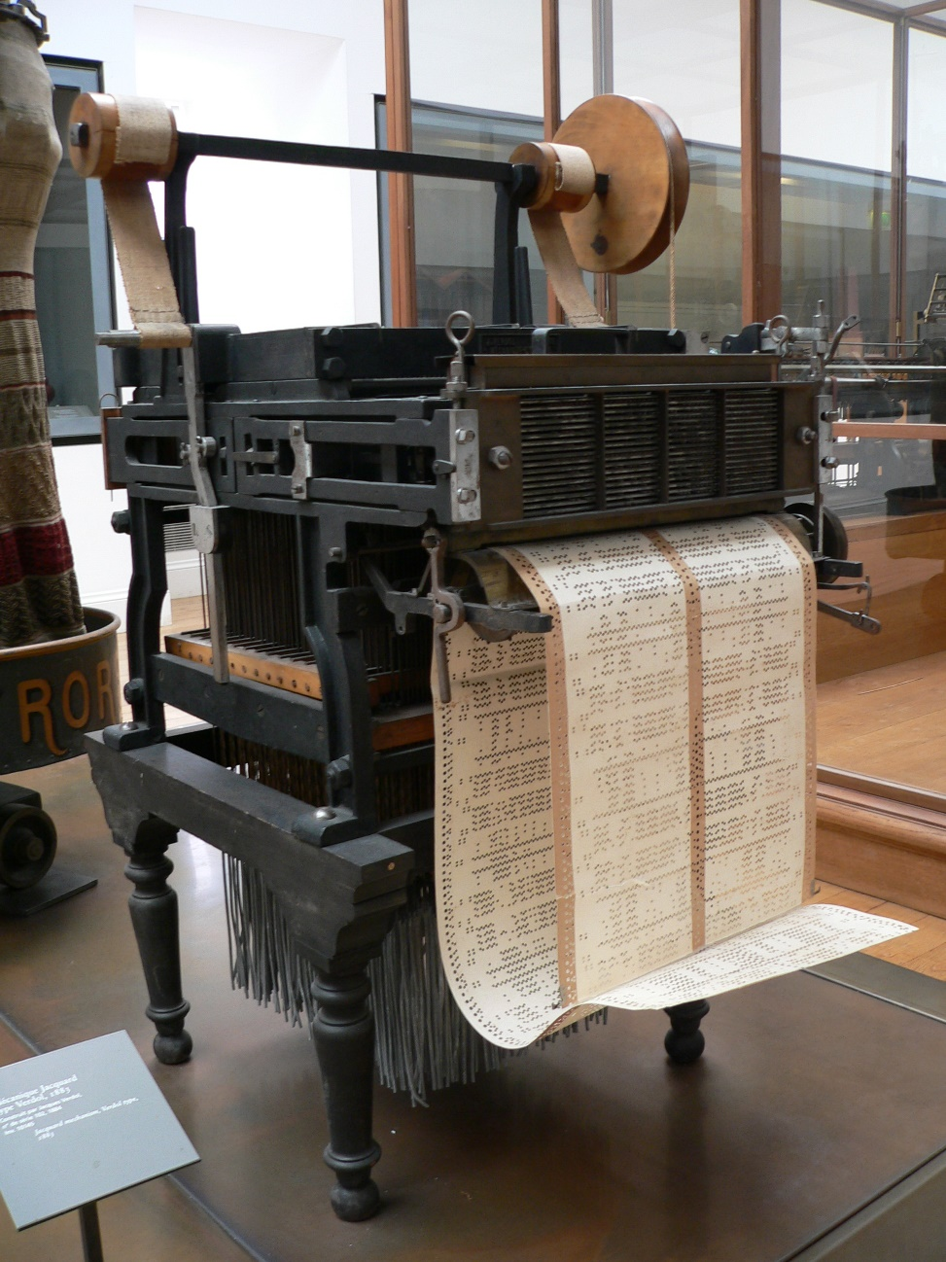
Jacquard’s Loom (1801)
Developed by Joseph-Marie Jacquard
Create a complex knitting very fast using a set of punches cards
Weavers hate this machine for obvious reason

Slide 7
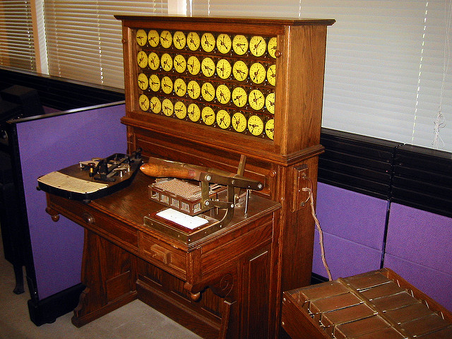
Hollerith’s Census Machine (1890)
USA wants to record all population data of its people (called US Census)
At that time, there are about 62 million people
Inspired by Jacquard’s Loom, Herman Hollerith built a machine that processed census data
The machine processed 1890 data within 3 months and result was published in 1892
He found a company which later becomes IBM

Slide 8
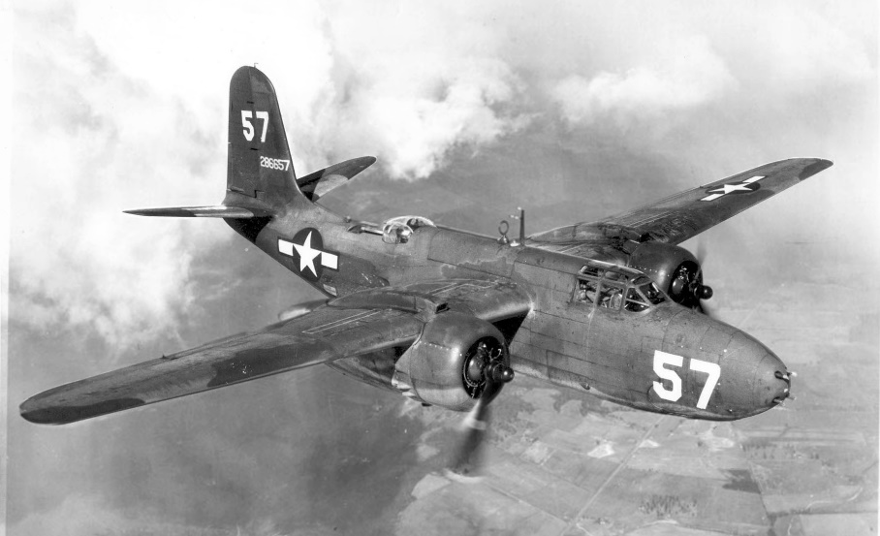
World War 2 Era
Introduce new complicated problems
How should troop be deployed?
How can the secret code be cracked?
Everything must be automated
Military was willing to spend a large sum of money on creating automated machine

Slide 9
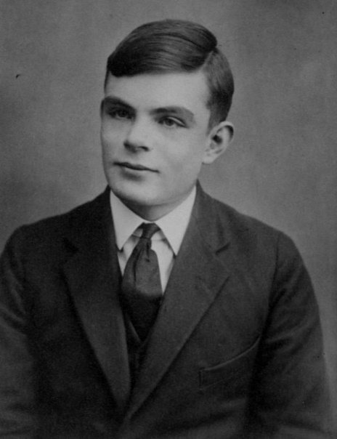
Alan Turing
Formularize the notions of computation and computability
Work for UK in developing a machine that can crack German Enigma code during World War 2, helping the Allies to defeat Nazis
Some said that his work had shortened the war by 4 years
After World War 2, he developed a test for machine intelligence now called Turing Test
The Turing Award is the highest award in computing (2015 award winners are the creators of today internet security procedure)

Slide 10
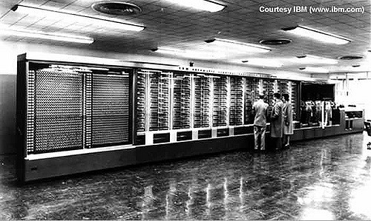
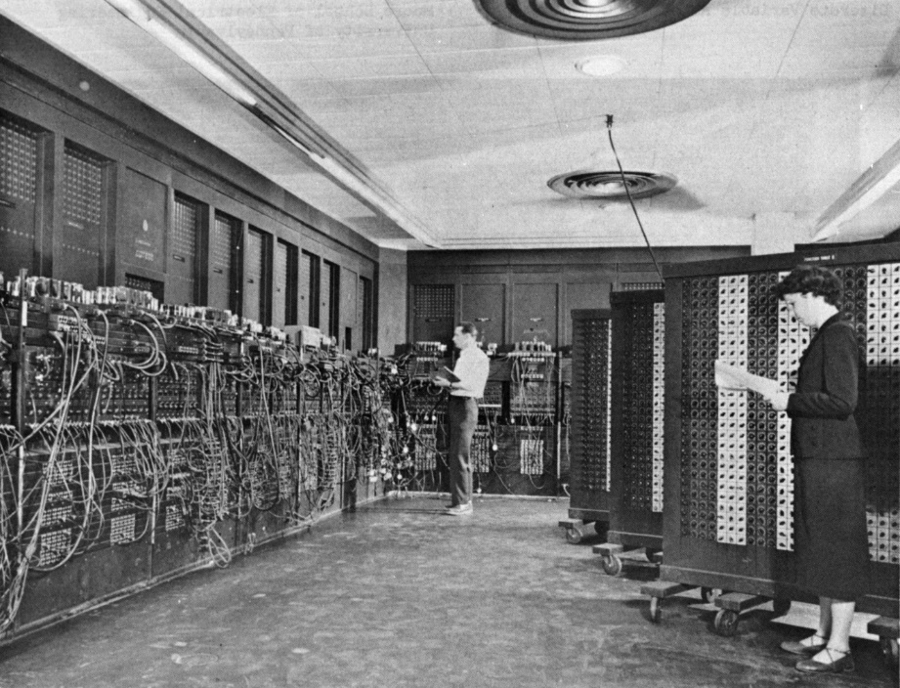
Very First Computer
Harvard Mark I
Electromechanical machine
ENIAC
Fully electronic machine
They were programmed externally
Programs determined by wiring

Slide 11
Von Neumann Architecture
Programs are considered data so they are stored along with data
Mauchy and Eckert were the first ones to come up with stored-program but John von Neumann publishes the concept and gained recognition
Machine are partitioned into 3 parts
Control Processing Unit
Memory
Input/Output

Slide 12
Von Neumann Architecture (2)
Central Processing Unit (CPU)
Memory
Input/Output

Slide 13
Von Neumann Architecture (3)
Central Processing Unit (CPU)
Memory
Registers
Program Counter
Arithmetic Logical Unit
Control Unit
Input/Output

Slide 14
Von Neumann Architecture (4)
Central Processing Unit (CPU)
Memory
1. Fetch
Registers
Program Counter
Arithmetic Logical Unit
Control Unit
Input/Output

Slide 15
Von Neumann Architecture (5)
Central Processing Unit (CPU)
Memory
2. Decode
Registers
Program Counter
Arithmetic Logical Unit
Control Unit
Input/Output

Slide 16
Von Neumann Architecture (6)
Central Processing Unit (CPU)
Memory
3. Execute
Registers
Program Counter
Arithmetic Logical Unit
Control Unit
Input/Output

Slide 17
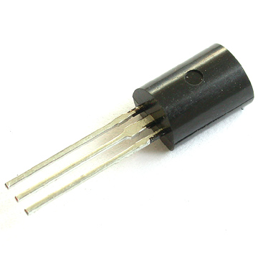
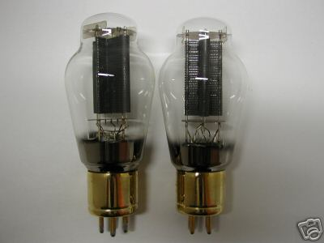
Transistors Era (1947)
Replace Vacuum Tubes with Transistors
More reliable, Smaller size
Lead to Integrated Circuit (Today’s CPU)

Slide 18
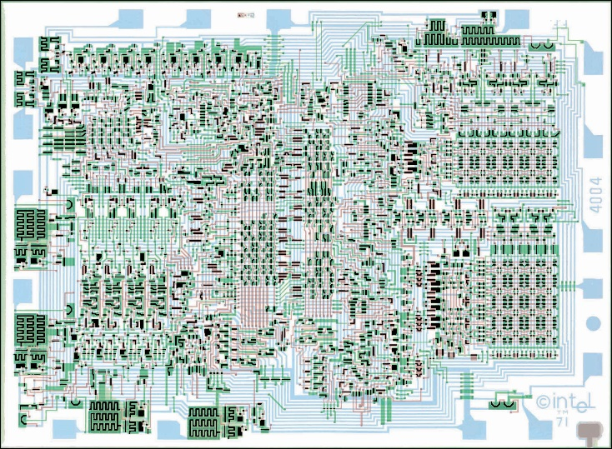
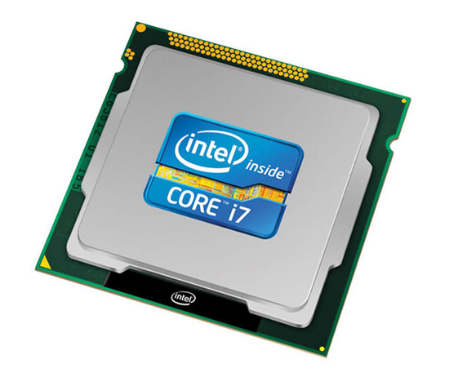
Microprocessor Era (1971)
Intel created the first microprocessor which is a CPU on a small chip (CPU used to live in a standalone box)
Personal computer revolution happened shortly after
1971
2016

Slide 19
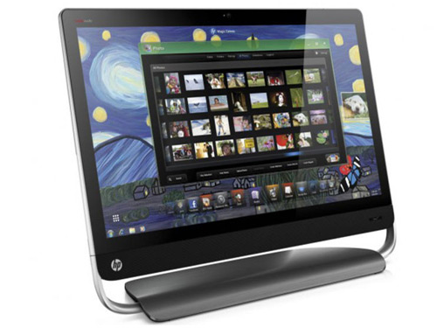
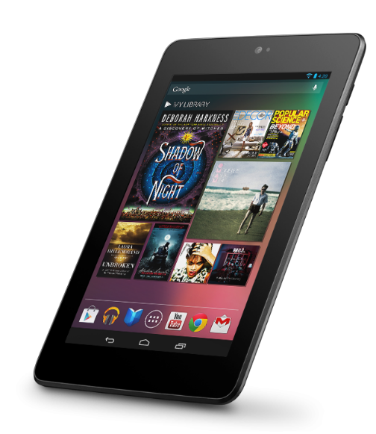
Modern Era (Present)
All-in-one machine that can do almost everything
Everyone household own at least one computer
Mobile phone becomes a larger market than computer (Advertisement needs to be optimized on mobile device, e.g., vertical screen)

Slide 20
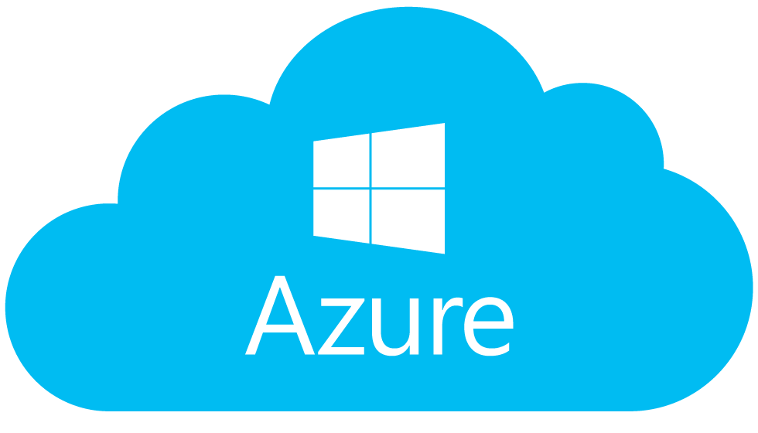
Future (of Computing) Era
Devices do not need to be powerful
Most computation will be performed on “the Cloud”
Google launches Google Cloud Platform
Microsoft launches Microsoft Azure

